Slide 1


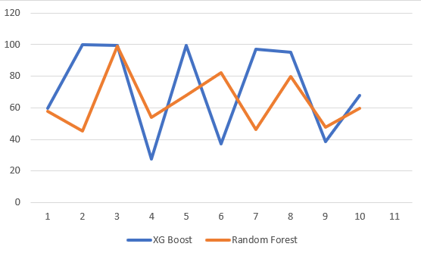
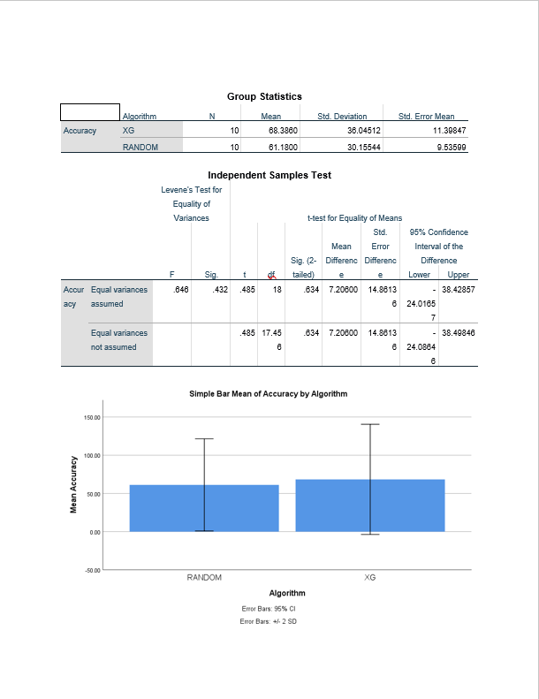
V.BHARATH 19 C.ANITHA
Name : S.Ashish Kumar
Register Number:192124142
Guided By : Dr .A.Muniyappan
Accuracy comparison of XG Boost and Random Forest in textile production forecasting.
INTRODUCTION
Investigating the application of machine learning in textile production prediction
Focusing on a comparative study between XGBoost and Random Forest models
Aiming to identify the most effective machine learning approach for textile production forecasting
Emphasizing the importance of selecting an optimal model for accurate and reliable predictions
Two groups were analyzed in this research.
Group 1: XGBoost Algorithm,
Group 2: Random Forest Algorithm.
Adopting a structured research approach, covering literature review, materials and methods, results, discussion, and conclusion sections.
Accurate forecasting of production outcomes is paramount for streamlining operations, minimizing waste, and ensuring optimal resource allocation.
Textile production encompasses a complex and multifaceted process, characterized by intricate interactions between raw materials, manufacturing parameters, and the final output.
Predicting Textile production
MATERIALS AND METHODS
Raw
Data
Data Preprocessing
Feature
Engineering
Learning
Algorithms
Model
Selection/
Evaluation
Post Processing
Classify/
Predict
New
Data
Accuracy
RESULTS
Algorithm statistics of XG Boost And Random Forest
 | Group | N | Mean | Std. Deviation | Std. Error Mean
Accuracy | RANDOM FOREST | 10 | 61.18 | 30.15544 | 9.53599
 | XG BOOST | 10 | 63.38 | 36.0354 | 11.39847
First Accuracy Graph
XG Boost vs Random Forest
The accuracy of Random forest is 61.18 and accuracy of XG boost is 63.38. X- axis denotes Random forest Vs XG boost and Y-axis denotes mean accuracy, with error bars indicating ±2 SD.
DISCUSSION AND CONCLUSION
Random Forest achieves an accuracy of 61.18%, while XGBoost demonstrates a higher accuracy rate of 63.38% in financial analysis.
The graph visually represents this performance contrast, with the X-axis depicting Random Forest vs. XGBoost and the Y-axis indicating mean accuracy. Error bars illustrate ±2 standard deviations.
Leveraging the predictive capabilities of XGBoost can notably improve the accuracy of financial indicator comparisons, thus facilitating more informed decision-making in finance.
This underscores the pivotal role of algorithmic analysis and data mining techniques in extracting valuable insights for investment decisions, risk assessments, and predicting market sentiments.
T-test Statistical analysis reveals a significance value of p=0.001 (independent sample T-test p<0.05), signifying a statistically significant difference between the two groups.
We used SPSS a data analysis of software made by IBM to perform analyzing on data obtained graph for both algorithms XG Boost and Random Forest.
This discrepancy in accuracy warrants further investigation into the underlying mechanisms of each algorithm.
Based on the conducted analysis, it can be inferred that for the given dataset and task, the XGBRegressor Optimizer algorithm is the preferred choice for achieving better predictive outcomes.
BIBLIOGRAPHY
Kantasa-Ard A, Nouiri M, Bekrar A, Ait el Cadi A, Sallez Y (2021) Machine learning for demand forecasting in the physical internet: a case study of agricultural products in Thailand. Int J Prod Res 59(24):7491–7515
Haberleitner H, Meyr H, Taudes A (2010) Implementation of a demand planning system using advance order information. Int J Prod Econ 128(2):518–526
Tsoumakas G (2019) A survey of machine learning techniques for food sales prediction. Artif Intell Rev 52(1):441–447
Wilson ZT, Sahinidis NV (2017) The ALAMO approach to machine learning. Comput Chem Eng 106:785–795
Mohammed A (2020) Towards ‘gresilient’ supply chain management: a quantitative study. Resour Conserv Recycl 155:104641
Goecks J, Jalili V, Heiser LM, Gray JW (2020) How machine learning will transform biomedicine. Cell 181(1):92–101
Hüllermeier E (2015) Does machine learning need fuzzy logic? Fuzzy Sets Syst 281:292–299
Sillanpää V, Liesiö J (2018) Forecasting replenishment orders in retail: value of modelling low and intermittent consumer demand with distributions. Int J Prod Res 56(12):4168–4185
Mohammed A (2020) Towards ‘gresilient’ supply chain management: a quantitative study. Resour Conserv Recycl 155:104641
Oliva R, Watson N (2009) Managing functional biases in organizational forecasts: a case study of consensus forecasting in supply chain planning. Prod Oper Manag 18(2):138–151

